Slide 1
Inductors in Series

Slide 2
An inductor is a passive element which is used in electronics circuits for temporary storage of electrical energy in the form of magnetic flux or simply magnetic field.
Inductance is the property of any coil which can sets up the magnetic flux when current passes through it.
Any device which has the property of inductance can be called an inductor.
Usually inductor is built in the form of a coil with copper material around the core of a magnetic (iron) or nonmagnetic medium (like air).

Slide 3
Inductors may be connected in series or parallel configuration depends on performance required by the circuit. These combinations are used to design more complex networks.
The total inductance of a circuit depends on the way inductors are connected may be in either series or parallel.
In addition, the way inductors are connected such that one inductance has no effect on other also varies the total inductance as compared with effect of magnetic coupling between inductors.
Therefore, inductors are arranged on the basis of their mutual inductance or magnetic coupling in series or parallel combinations.

Slide 4
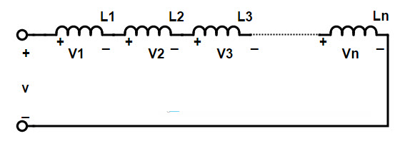
Inductors Connected in Series
Assume that inductors connected in the circuit do not have any coupling between them.
This implies that there are no flux lines from one inductor linking with another, and hence there will be no mutual flux between the coils.
The end to end connection of two or more inductors is called “series connection of inductors”.
In this connection the effective turns of the inductor increases. The series connection of the inductors is shown in below diagram

Slide 5
The inductance of series connected inductors is calculated as the sum of the individual inductances of each coil since the current change through each coil is same
This series connection is similar to that of the resistors connected in series, except the resistors are replaced by inductors.
If the current I is flowing in the series connection and the coils are L1, L2, and so on, the common current in the series inductors is given by
i_{Total} = i_{l1} i_{L2} = i_{L3}. . . = i

Slide 6
If the individual voltage drops across each coil in this series connection are V_{L1}, V_{L2}, V_{L3}, and so on, the total voltage drop between the two terminals V_{T} is given by
V_{Total} = V_{L1} + V_{L2} + V_{L3}…. + V_{n}
As we know that the voltage drop can be represented in terms of self inductance L, this implies
V = L di/ dt.
this can also be written as
L_{T} di/dt = L₁ di/dt + L₂ di/dt + L₃ di/dt + . . . + L_{n} di/dt
therefore the total inductance is
L_{Total} = L₁ + L₂ + L₃ + ….. + L_{n}
This means the total inductance of the series connection is the sum of individual inductances of all inductors.
The above equation is true when there is no mutual inductance affect between the coils in this series configuration.

Slide 7
Problem 1:
If a circuit has 3 inductors of 60 Henry, 30 Henry and 20 Henry connected in series, what will be the total inductance of the series?
Sol: We know that the formula for total inductance of series,
L_{Total} = L₁ + L₂ + L₃ + ….. + L_{n}
Given that L₁ = 60 Henry
L₂ = 30 Henry
L₃ = 20 Henry
The total inductance, L_{Total} = L₁ + L₂ + L₃ = ________ Henry.

Slide 8
Mutually Connected Inductors in Series
Now consider that inductors are connected such that magnetic field of one coil affects the other.
When two or more inductors are connected in series, then the inductance of one inductor will be affected by the magnetic field produced by the other coil.
This is called mutual inductance and the coils are called “Mutually connected inductors”.
This mutual inductance may increase or decrease the total inductance of the series circuit.
The factor that affects the mutual inductance of a series connected of inductors is the distance between the coils and their orientation.
The mutually connected inductors can coupled in two types
1) Cumulatively coupled or Series Aiding
2) Differentially coupled or Series opposing

Slide 9
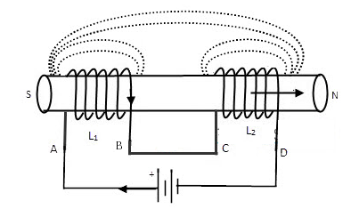
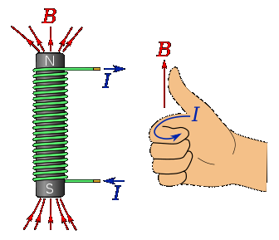
Cumulatively Coupled Inductors in Series
the magnetic fluxes produced by the inductors are in the same direction to the flow of current through them, then the coils are known as “Cumulatively coupled”.
In this series aiding or cumulative coupled circuit, the current enters or leaves the terminals of coils at any instant of time are in the same direction.
The figure below shows the connection of two inductors in series aiding arrangement.

Slide 10
If we pass the current through the cumulatively coupled coils (between the nodes A & D) in the same direction, the voltage drop of each individual coil will affect the total inductance of the series.
Let self inductance of the coil-1 is L₁, self inductance of the coil-2 is L₂ and the mutual inductance is M between coil 1 and coil2.
Self induced emf in coil-1 is
e1 = L₁ di/ dt
Mutual induced emf in coil-1 due to change of current in coil-2 is
eM1 = M di/ dt
Similarly, Self induced emf in coil-2 is
e2 = L₂ di/ dt
Mutual induced emf in coil-2 due to change of current in coil-1 is
eM2 = M di/ dt

Slide 11
Therefore, total induced emf in the series aiding circuit is given as
e = L₁ di/ dt+ L₂ di/ dt+2M di/ dt
= (L₁+ L₂ + 2M) di/ dt
If L_{T} is the total inductance of the circuit, the total induced emf will be equivalent to
e = L_{T} di/ dt
Substituting in the above equation, we get
L_{T} di/ dt = (L₁+ L₂ + 2M) di/ dt
Therefore, L_{T} = (L₁ + L₂ + 2M)

Slide 12
Problem 2: If two coils of inductance 70 mH and 30 mH are connected in series, then find the total cumulative inductance of the series connected inductors. Consider the mutual inductance of the combination of the two coils is 40 mH.
Sol: Given that, L₁ = 70 mH
L₂ = 30 mH
M = 40 mH
Applying the formula for cumulatively connected inductors,
L_{T} = L₁ + L₂ + 2M
=____ mH

Slide 13
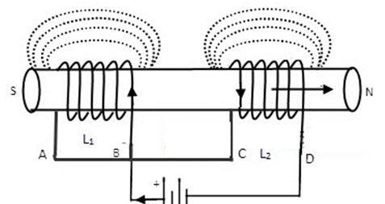
Differentially Coupled Inductors in Series
if the magnetic fluxes produced by the inductors are in the opposite direction to each other, then the coils are known as “Differentially coupled” or series opposition connection.
The figure below shows the connection of two inductors in series opposition arrangement

Slide 14
In differentially coupled coils, the magnetic flux fields may produce in same direction or opposite direction. Let the self inductance of the coils are L1 and L2 and the mutual inductance is M.
Here mutual inductance will be aided to each coil self inductance due to the circuit configuration. Therefore, total induced emf in the series opposing circuit is given as
e = L₁ di/dt + L₂ di/dt -2M di/dt
= (L₁+ L₂ – 2M) di/dt
If L_{T} is the total inductance of the circuit, the total induced emf will be equivalent to
e = L_{T} di/ dt
Substituting in the above equation, we get
L_{T} di/dt = (L₁+ L₂ – 2M) di/dt
Therefore, L_{T} = (L₁ + L₂ – 2M)

Slide 15
Problem 3: If two coils of inductance 70 mH and 30 mH are connected in series, then find the total differential inductance of the series connected inductors. Consider the mutual inductance of the combination of the two coils is 40 mH.
Sol: Given that, L₁ = 70 mH
L₂ = 30 mH
M = 40 mH
Applying the formula for differentially connected inductors,
LT = L1 + L2 – 2M
= _____mH

Slide 16
Summary
The end to end connection of two or more inductors is called “series connection of inductors”. L_{T} = L₁ + L₂
The total inductance of the series connected inductors is always greater than the largest inductor in that series.
If the magnetic fluxes produced by the inductors are in the same direction to the flow of current through them, then the coils are known as “Cumulatively coupled”. L_{T} = L₁ + L₂ + 2M
If the magnetic fluxes produced by the inductors are in the opposite direction to each other, then the coils are known as “Differentially coupled”. L_{T} = L₁ + L₂ – 2M

